Slide 1
Vivado Design Flow
Artix-7
Vivado 2014.2 Version

Slide 2
Objectives
After completing this module, you will be able to:
Explain how the design analysis features of the Vivado IDE can help in FPGA design development
List the main features of the Vivado IDE
Describe the Vivado IDE Design flow
Introduce the scripted Vivado IDE design flows

Slide 3
Outline
Vivado IDE Features and Benefits
Vivado Design Suite Introduction
Vivado Design Flow
Summary

Slide 4
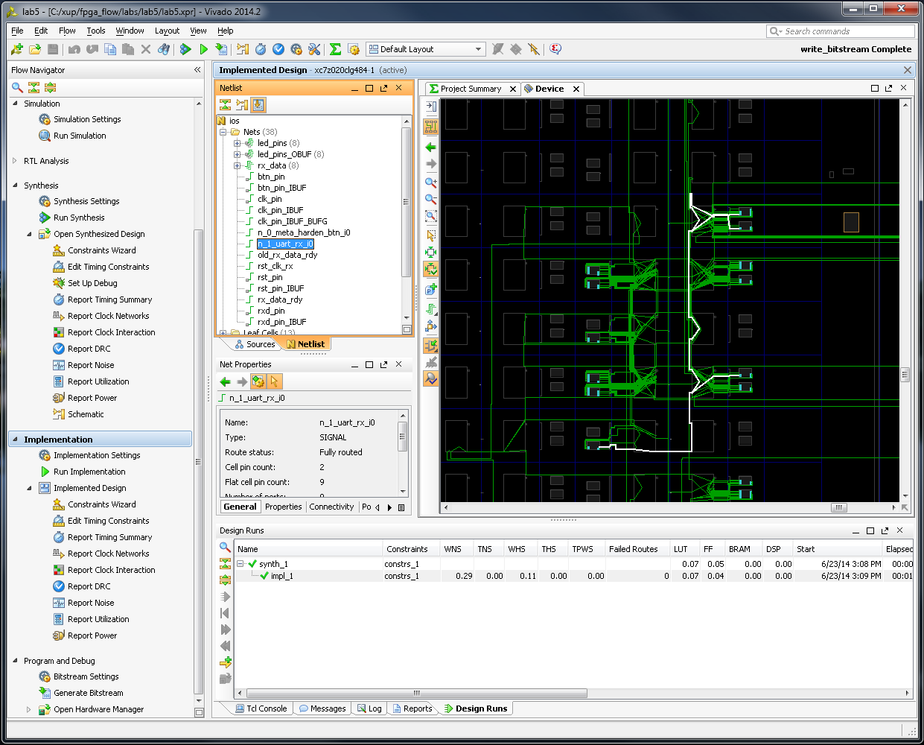
Vivado IDE Solution
Interactive design and analysis
Timing analysis, connectivity, resource utilization, timing constraint analysis, and entry
RTL development and analysis
Elaboration of HDL
Hierarchical exploration
Schematic generation
XSIM simulator integration
Synthesis and implementation in one package
I/O pin planning
Interactive rule-based I/O assignment

Slide 5
Who Should Use Vivado?
Designers needing an interactive design approach
Analysis and area constraints to drive place & route
Challenging designs
Large devices, complex constraints, and high device utilization
Advantages are also seen with small devices
Designs experiencing implementation issues
Performance, capacity, run time, and repeatability
Designs requiring implementation control
Users looking for options other than just a pushbutton flow
Visualize design issues from many aspects
Block-based design constraints
Designs targeting the 7-Series (or newer) devices
Notes:
Typical designers are involved in complex, high-density designs. They do not mind using a more interactive and iterative approach, as opposed to a pushbutton flow (as long as it produces improved timing results). Vivado IDE users also include those who want to be more involved (in control) of what the implementation tools are doing.
The productivity gains enabled by the Vivado IDE will help reduce the overall implementation iterations required by these types of designs.
Typical designers need extra performance and have experienced implementation issues previously.
Often, complex designs require many iterations to finalize the performance. This is because designers run the risk of not meeting their timing with each iteration when running implementation on the entire design. The use of area constraints can improve the consistency of your timing results, although it does not guarantee meeting your timing objectives.

Slide 6
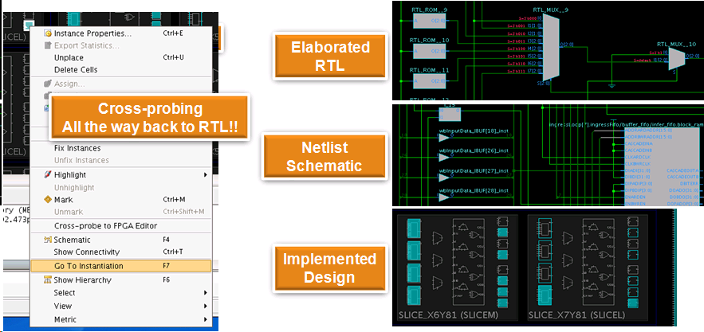
Vivado’s Visualization Feature
Visualize and debug your design at any flow stage
Cross-probing between netlist/schematic/RTL

Slide 7
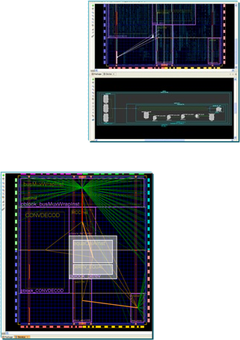
Gain Faster Timing Closure
Analyze multiple implementation results
Highlight failing timing paths from post-route timing analysis
Quickly identify and constrain critical path logic
Hierarchical floorplanning
Guide place & route toward better results
Utilization estimates
All resource types shown for each Pblock
Clocks or carry chains
Connectivity display
I/Os, net bundles, clock domains
Notes:
The Vivado IDE provides a comprehensive environment for analyzing timing issues and easily constraining timing-critical logic to improve performance. Results can be used to plan a floorplan of the design by determining what logic should be grouped together and where it should placed on the die. When timing-critical logic is grouped closer together, the implementation tools can use faster routing resources to improve timing.
Grouping logic is performed with physical blocks (called Pblocks) by selecting logic in a variety of different ways.
The Vivado IDE also provides resource utilization estimates to help size any Pblocks. These same statistics report clock information, carry chain size, and a variety of other useful information.
The Vivado IDE provides excellent insight into the design by displaying I/O interconnect as well as Pblock net bundles. Inter-Pblock net bundles change color and size depending on the number of signals shared by Pblocks. This makes it easy to see heavily connected Pblocks and the data flow through the FPGA. Designers can then take corrective action to place heavily connected Pblocks closer or merge them into one Pblock.

Slide 8
Tcl Capability
Tcl Console enables the designer to actively query the design netlist
Full Tcl scripting support in two design flows
Project-based design flow provides easy project management by the Vivado IDE
Non-project batch design flow enables entire flow to be executed in memory
Journal and log files can be used for script construction

Slide 9
Outline
Vivado IDE Features and Benefits
Vivado Design Suite Introduction
Vivado Design Flow
Summary

Slide 10
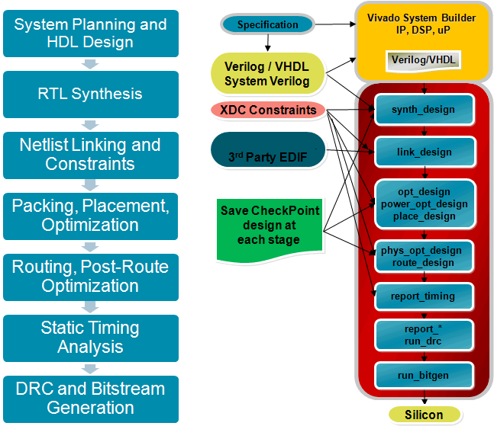
Typical vs Vivado Design Flow
Interactive IP plug-n-play environment
AXI4, IP_XACT
Common constraint language (XDC) throughout flow
Apply constraints at any stage
Reporting at any stage
Robust Tcl API
Common data model throughout the flow
“In memory” model improves speed
Generate reports at all stages
Save checkpoint designs at any stage
Netlist, constraints, place and route results
Notes:
synth_design is normal except that it now can read in XDC constraints into synthesis. The Vivado IDE includes a timing-driven synthesis tool that uses a common constraint language throughout the flow. From synthesis all the way through place and route.
Netlist linking is done in link_design. Here if you do have third-party EDF, the files can be read into the Vivado IDE.
opt_design, power_opt_design, and place_design are the packing and placement functions. power_opt_design is optional, however.
phys_opt_design is also optional. The significant thing is that all of data is stored in one data model.
You can run that entire flow in memory and never write anything files out when using the non-project batch design flow. But in any flow there is no data translation, no data model. There are huge advantages to that in terms of speed. Checkpoints can be saved at any stage of the design flow when using the non-project batch design flow. A checkpoint is basically a snapshot of your design in time. All of these commands can be scripted, so the flow is very flexible.
The single data model in memory allows you to do a lot of things, such as cross-probing and fixing your timing at the end of the implementation without having to reimplement again.

Slide 11
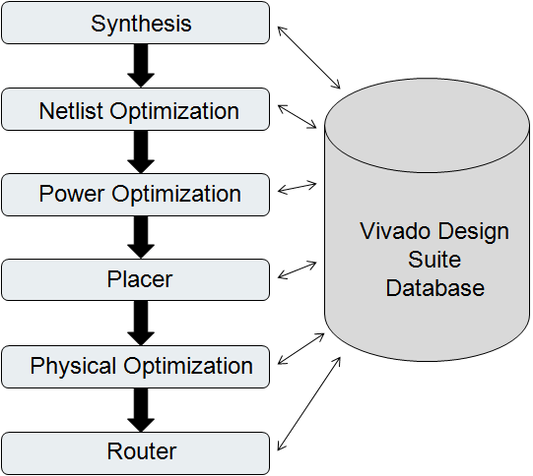
Design Database
Processes access the underlying database of your design
Each process operates on a netlist and will modify the netlist or create a new netlist
Different netlists are used throughout the design process
Elaborated
Synthesized
Implemented

Slide 12
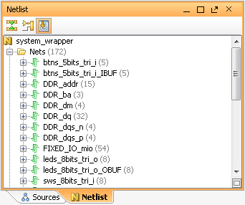
What is a Netlist?
A Netlist is a description of your design
Consists of cells, pins, port and nets
Cells are design objects
Instances of user modules/entities
Instances of library Basic Elements (BELs)
LUTs, FF, RAMs, DSP cells, etc…
Generic technology representations of hardware functions
Black boxes
Pins are connection points on cells
Ports are the top level ports of your design
Nets make connections between pins and from pins to ports

Slide 13
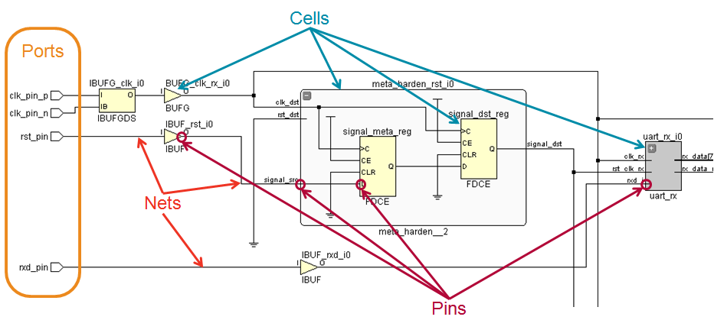
Netlist Objects
Notes:
Ports are the primary inputs and outputs of the current design (normally the top level module).
Pins are the connections to instances – both instantiations of hierarchical objects and primitive cells.

Slide 14
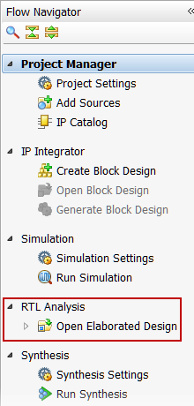
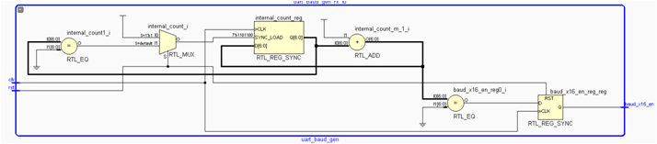
Elaborated Design
Accessed through the Flow Navigator by selecting Open Elaborated Design
Representation of the design before synthesis
Interconnected netlist of hierarchical and generic technology cells
Instances of modules/entities
Generic technology representations of hardware components
AND, OR, buffer, multiplexers, adders, comparators, etc…

Slide 15
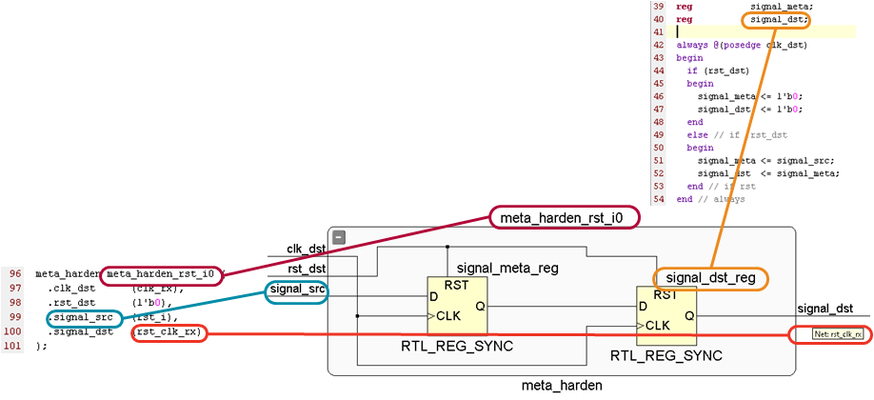
Object Names in Elaborated Design
Object names are extracted from RTL
Instance and pin names of hierarchical objects
Inferred flip-flops from underlying reg/signal/logic
Suffix _reg is added
Nets from underlying reg/signal/logic when it makes sense

Slide 16
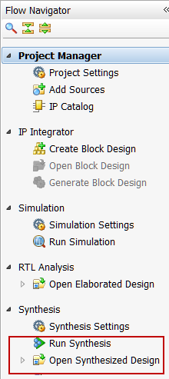
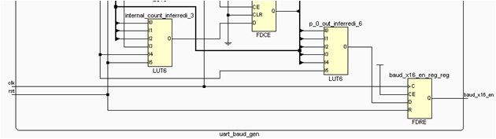
Synthesized Design
Accessed through the Flow Navigator by selecting Open Synthesized Design
Representation of the design after synthesis
Interconnected netlist of hierarchical and Basic Elements (BELs)
Instances of modules/entities
BELs
LUTs, flip-flops, carry chain elements, wide MUXes
Block RAMs, DSP cells
Clocking elements (BUFG, BUFR, MMCM, …)
I/O elements (IBUF, OBUF, I/O flip-flops)
Object names are the same as names in the elaborated netlist when possible

Slide 17
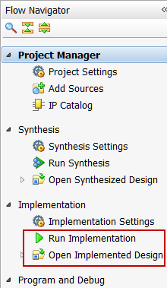
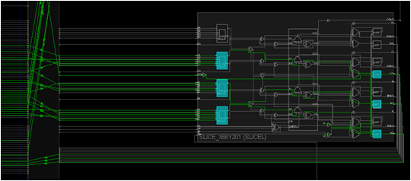
Implemented Design
Accessed through the Flow Navigator by selecting Open Implemented Design
Representation of the design during and after the implementation process
Structurally similar to the Synthesized Design
Cells have locations, and nets are mapped to specific routing channels

Slide 18
Project Data
All project data is stored in a project_name directory containing the following basic set of directories:
project_name.xpr file: Vivado project file, contains project settings
project_name.runs directory: Contains all run data
project_name.srcs directory: Contains all imported local HDL source files, netlists, and XDC files
project_name.data directory: Stores floorplan and netlist data

Slide 19
Journal and Log Files
Journal file (vivado.jou)
Contains just the Tcl commands executed by the Vivado IDE
Log file (vivado.log)
Contains all messages produced by the Vivado IDE, including Tcl commands and results, info/warning/error messages, etc.
Location
Linux: directory where the Vivado IDE is invoked
Windows via icon: %APPDATA%\Xilinx\Vivado or C:\Users\<user_name>\AppData\Roaming\Xilinx\Vivado
Windows via command line: directory where the Vivado IDE is invoked
From the GUI
Select File > Open Log File
Select File > Open Journal File

Slide 20
Checkpoints
Saves the database from memory to disk
Netlist – edif (eventually a Verilog netlist)
Constraints – xdc
Placement/routing/config db – xdef
Tcl commands
write_checkpoint <filename>
Results in a filename.dcp file, which is a compressed file
Can unzip this file if needed: filename.edf, filename.xdc, filename.xdef, filename.wdf, and dcp.xml
read_checkpoint <filename>
Can read and write in the IDE as well
When read in gives a project-less setup
Can open and modify checkpoints in IDE

Slide 21
Outline
Vivado IDE Features and Benefits
Vivado Design Suite Introduction
Vivado Design Flow
Summary

Slide 22
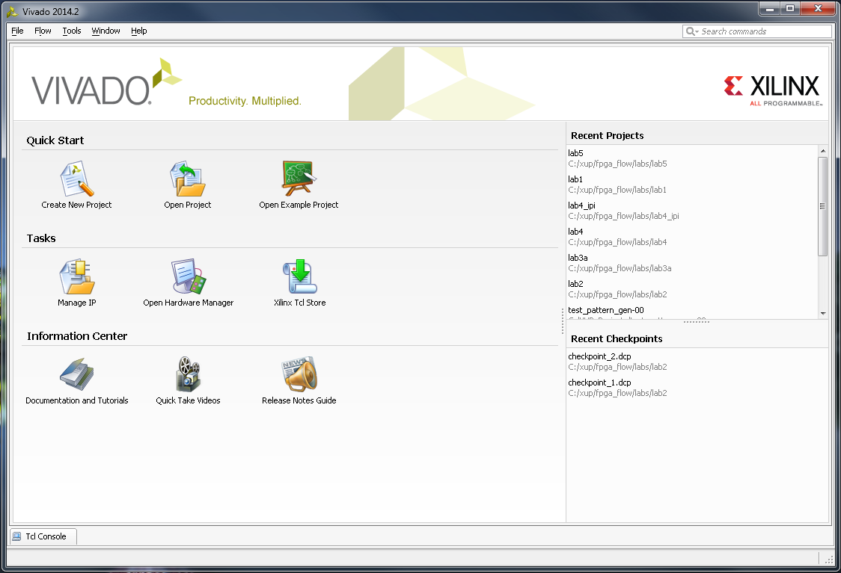
Getting Started Jump Page
All buttons grouped by functionality
Quick Start
Previous projects can quickly opened
Links to create new or example projects
Tasks
IP management, hardware manager, Tcl Store
Helpful links
Docs and tutorials
Invokes PDF viewer for documentation
Video overviews of features and concepts
Notes for the current software release are
Tcl Console for command line access

Slide 23
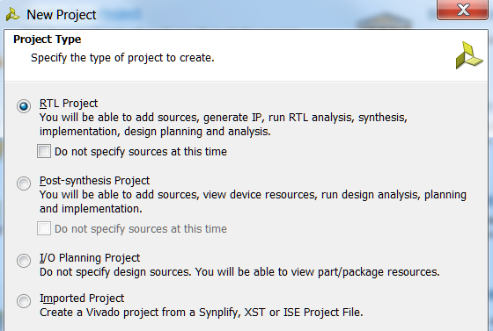
New Project Creation Wizard
Very first step in project creation with four choices
Four different types of projects:
RTL
Front-to-back (even for Block Designs)
Post-synthesis
EDIF or NGC
I/O planning
For early pin testing
No design sources
Import Project imports existing project from ISE Project Navigator, XST, and Synplify
Notes:
RTL Project:
The RTL Project environment enables analysis of the compiled RTL design including logic exploration, resource and power estimation, DRCs, and I/O pin planning.
Post-synthesis Project:
This is where pre-implementation design analysis, debug core insertion, and constraint definition is performed. You can explore various constraints sets, devices, and implementation options.
Import ISE tool results:
The Implemented Design environment loads the netlist and implementation results directly from the run directory to ensure that the viewed data represents the launched run.

Slide 24
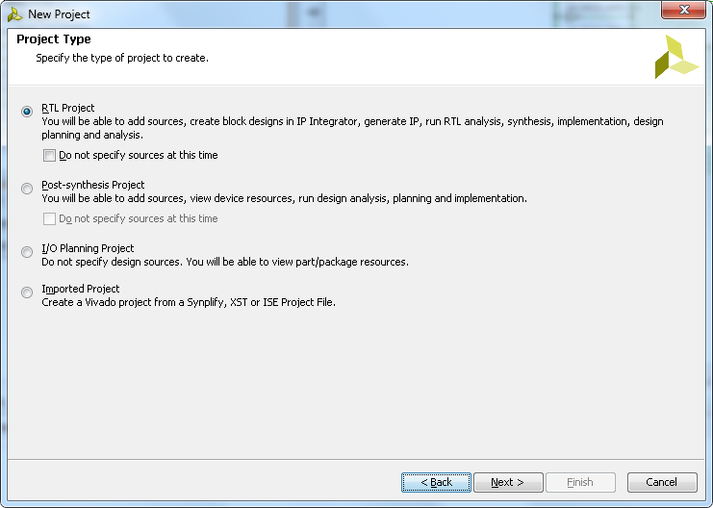
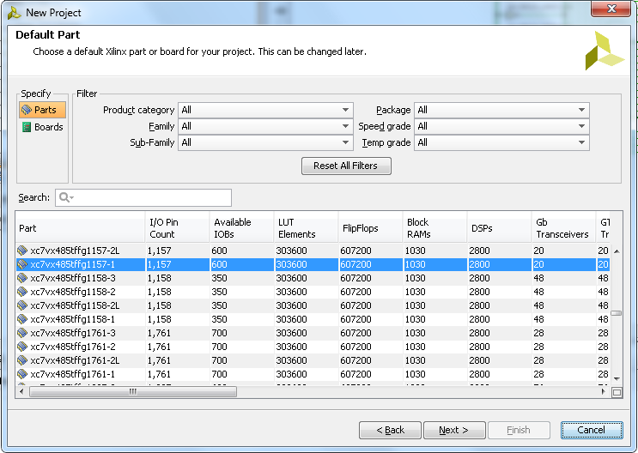
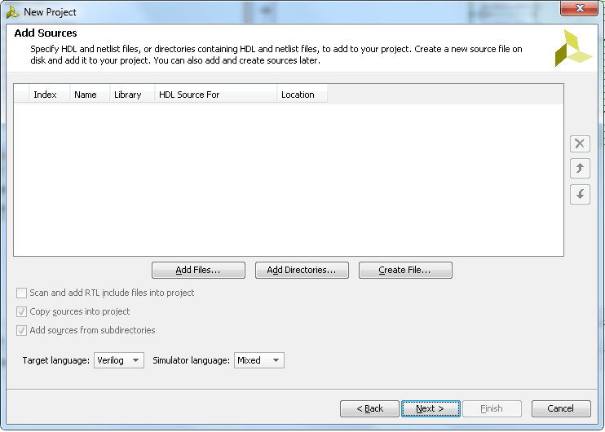
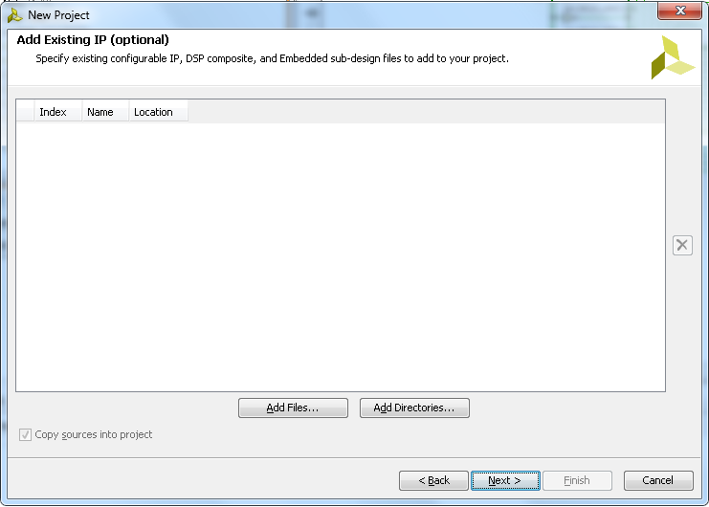
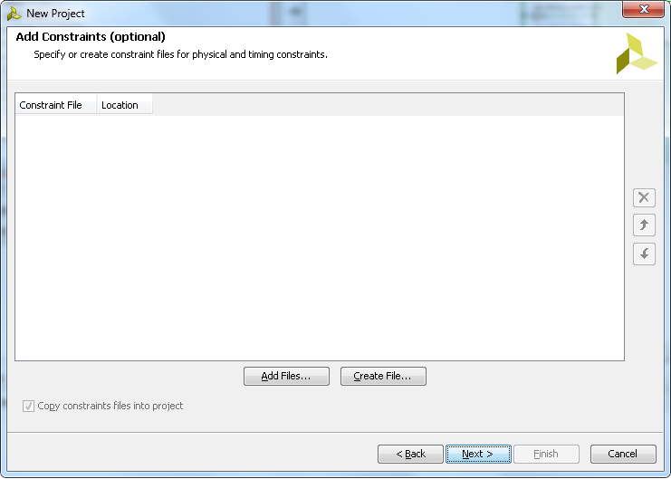
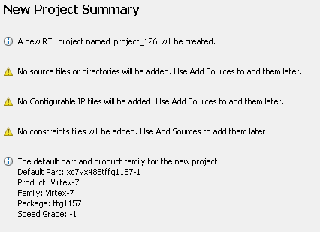
Project creation flow (RTL/Synthesized Design)
Defines the project name and location
Select source files in RTL project creation
All recognized source files, Verilog, VHDL, in the directory and subdirectories, can be added
Select post-synthesized netlist in Post-synthesized project creation
All synthesized files in the directory and subdirectories, are added
Select constraint files
One or more constraints files including IP specific and top-level can be added
Select target device or pre-defined board
Reference original existing files or import and copy them into the project

Slide 25
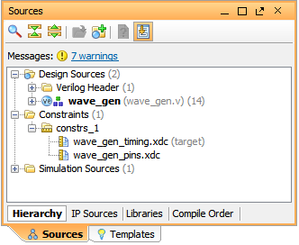
Constraints File Management
Constraint sets are a collection of XDC files
A project can contain multiple constraint sets
For a constraints set to be applied, it must be set to "active"
Any constraint set can be made active by right-clicking and selecting Make Active
Target XDC
The XDC file in a constraint set to which new constraints are written
From the Constraints Wizard for example
Target XDC can be specified by right-clicking and selecting Set As Target Constraint File

Slide 26
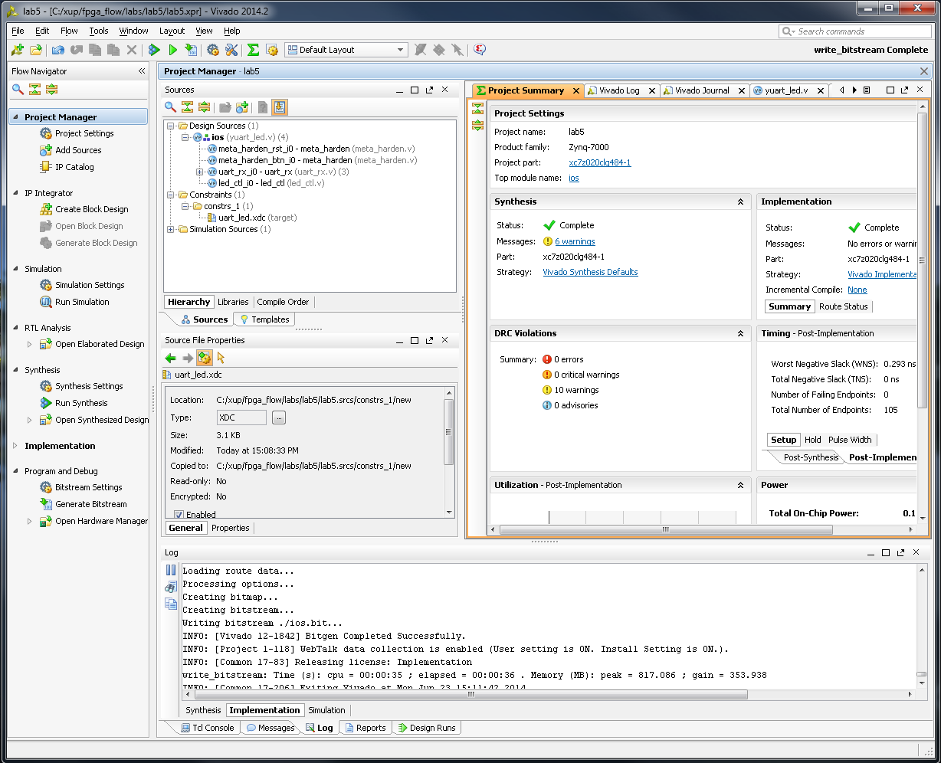
Project Navigator
Used to manage sources, customize IP, and view project details in the Project Summary
Flow Navigator
Sources view
Hierarchical display of sources, including constraints files
IP Sources and Libraries view
HDL and netlists including references to library and location
Project Summary
Gives access to device utilization (resources), timing summary, and strategy information
Tcl Console, Messages, Compilation, Reports, and Design Runs

Slide 27
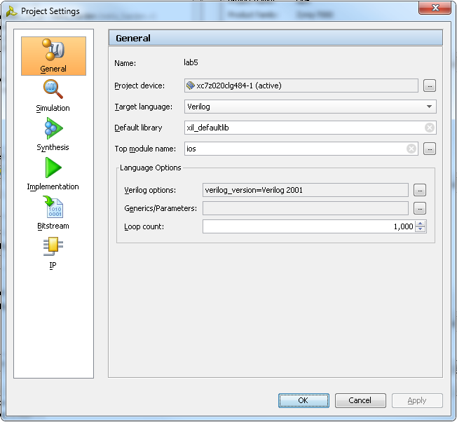
Project Settings
General settings
Select device
Target HDL language
Simulation tool (Vivado simulator included)
Top module name
Language options
Other settings are covered in their respective modules

Slide 28
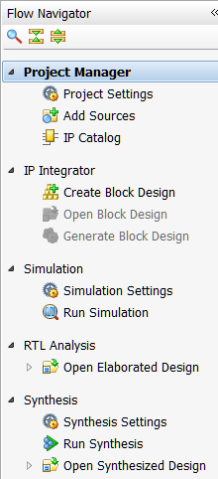
Flow Navigator – RTL Project
Configure project sources
Add HDL source files, constraints files, simulation files, block designs
IP Integrator
Create, open, generate a block design
Run Simulation
XSIM simulator included
Behavioral, post-synthesis, post-implementation
RTL Analysis
Open Elaborated Design button: Loads the elaborated RTL design
Run Synthesis
Timing driven
Open Synthesized Design button: Loads synthesized netlist

Slide 29
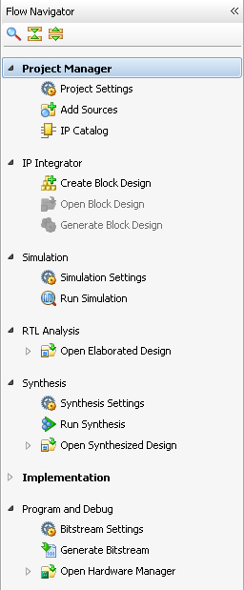
Flow Navigator – RTL Project, cont’d…
Run Implement button: Runs implementation tools
link, opt, power_opt, place, phys_opt, and route
Open Implemented Design button: Loads implemented design
Program and Debug: Launches programming and debugging tools
Open Hardware Manager to program the FPGA
Hardware Manager also contains debug capabilities

Slide 30
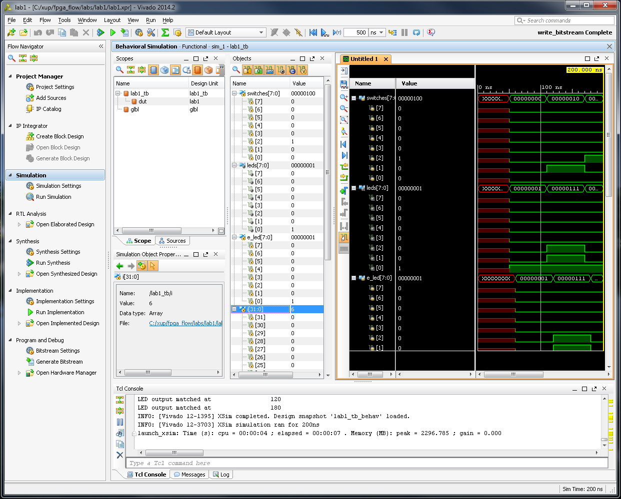
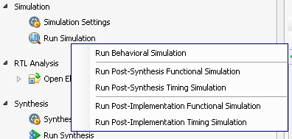
Simulation
The Vivado simulator, XSIM, supports RTL, netlist, and timing simulation
Part of the Vivado installation

Slide 31
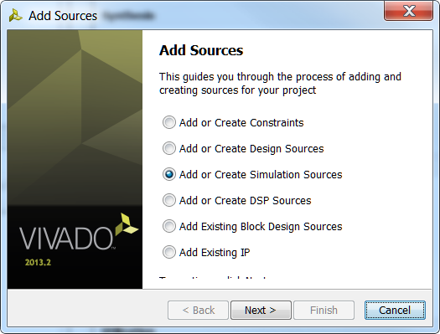
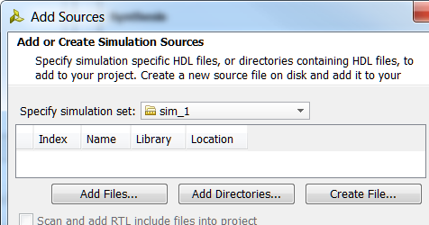
Adding Testbench Files
Testbench sources (*.V or *.VHD) must be added separately from design sources
In the Flow Navigator, click Add Sources
Select Add or Create Simulation Sources option and click Next
Click on Add Files…, Add directories… buttons if the testbench file is already available or click on Create File… button to create a new testbench file
Select a file type- Verilog, Verilog Header, SystemVerilog, or VHDL
Browse to an existing testbench or enter a filename to create

Slide 32
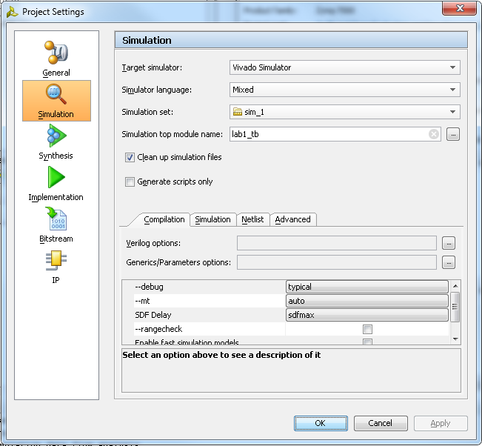
Simulation Settings
Allows selection of compilation and simulation properties
From the Flow Navigator, click Simulation Settings
The simulation top module is the testbench you have written and specify
Additional options can be entered
More Compilation Options field under Compilation tab
More Simulation Options field under Simulation tab
Refer to the Vivado Design Suite Simulation Guide (UG900) for more information

Slide 33
Simulation Results
Graphical waveform display
Toolbar buttons for adding markers, measuring delays, and zooming
Buses can be expanded to view individual signals
Dividers can be inserted to visually isolate groups of related signals
Console displays any messages output from testbench
By default, the top-level signals are displayed

Slide 34
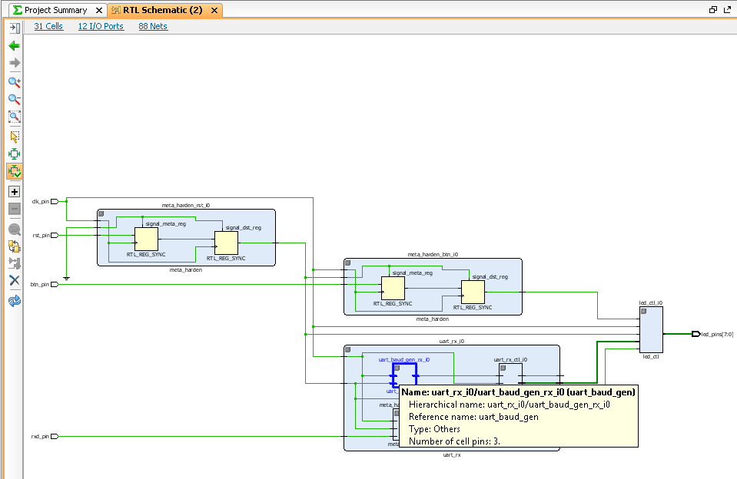
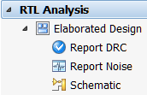
After Elaboration
The RTL schematics is available
RTL schematics reflect the RTL code as closely as possible
Useful for visualizing RTL design
DRC can be run on design
Report noise identifies potential simultaneous switching violation
Notes:
After you have elaborated the design, the Project Manager appears. Note that the Flow Navigator has changed (note the new options under RTL Analysis). The figure shows the RTL Schematic layout, but other views can be selected.
RTL Netlist window: Shows a name for each primitive in the design.
As each is selected, the Instance Properties view shows specific details. Physical constraints: list Pblocks associated with the design. Device view: Shows the specific resources on the die that are selected. It also shows location constraints (LOCs) and range assignments on Pblock.

Slide 35
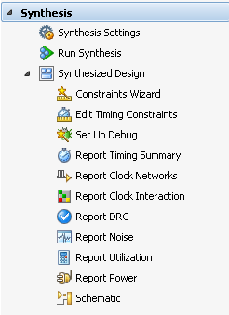
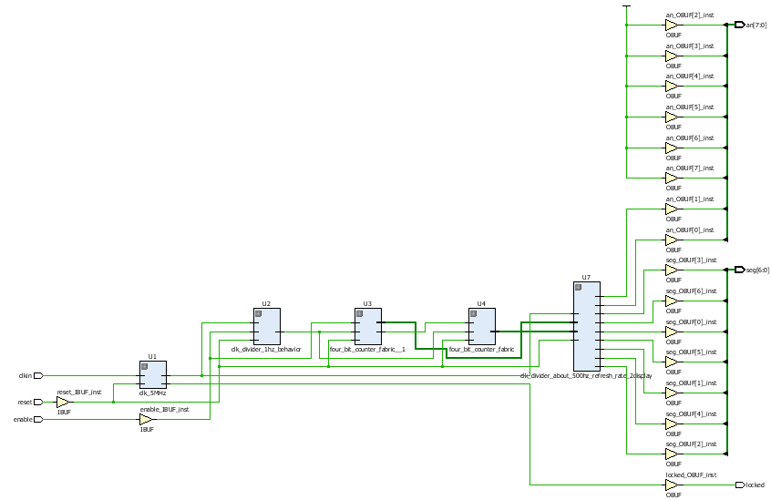
After Synthesis
The Flow Navigator changes from Elaboration to reflect the operations available after Synthesis
The Constraints Wizard lets the tools identify and constrain paths in the design
The schematic view will be opened including input/output buffers
Views can selected by purpose
All timing information is only an estimate (until implementation has completed)
Setup debug tool allow signals to be marked for debug

Slide 36
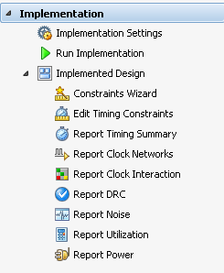
After Implementation
Sources and Netlist tabs do not change
Now as each resources is selected, it will show the exact placement of the resource on the die
The Constraints Wizard is also accessible at this stage
Timing results have to be generated with the Report Timing Summary
As each path is selected, the placement of the logic and its connections is shown in the Device view
This is the cross-probing feature that helps with static timing analysis

Slide 37
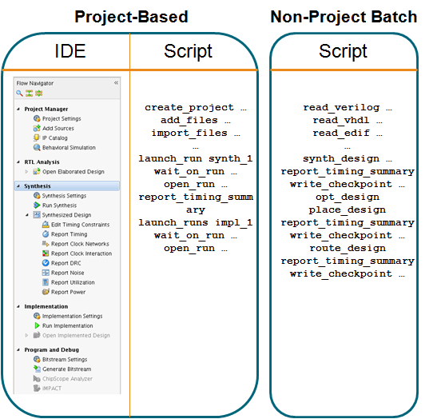
Project Based vs Non-Project Batch Flows
Vivado tools support two flows
Project based
Non-project batch
Non-project batch flow
No project infrastructure
Tcl based
Can use GUI for visualization via the start_gui command
Must manually create reports and checkpoints via commands
Project-based flow
Project infrastructure is saved in *.XPR file
Reports/state/runs/cross-probing is available
IDE GUI or Tcl script both available

Slide 38
Outline
Vivado IDE Features and Benefits
Vivado Design Suite Introduction
Vivado Design Flow
Summary

Slide 39
Summary
Features and benefits of the Vivado IDE include
Improved performance and device utilization with the use of Pblocks and area constraints
Performance predictability
Design analysis features that speed a designer's ability to gain timing closure Tcl features (commands) that make scripting easier and powerful
Vivado tools use a common data model throughout the FPGA design process
This yields runtime and memory resource benefits to the user
Vivado tools support scripting in non-project batch and project-based design flows
Vivado tools support the use of Tcl for all commands
Vivado tools use a common constraint language (XDC) throughout the design process
This enables synthesis optimization significantly better than the ISE software
Pushbutton flows for most designs
Advanced tools for challenging designs

